Slide 1
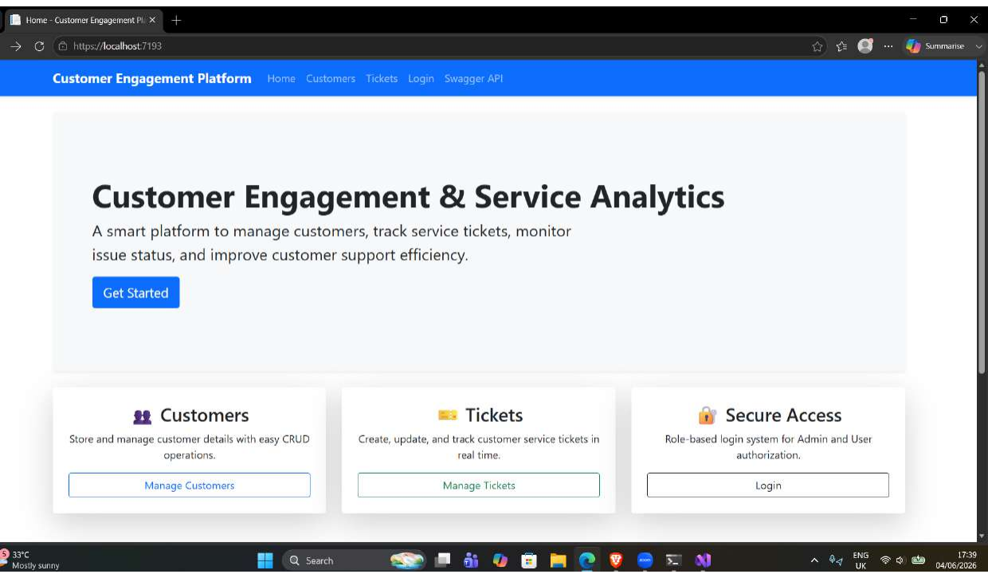
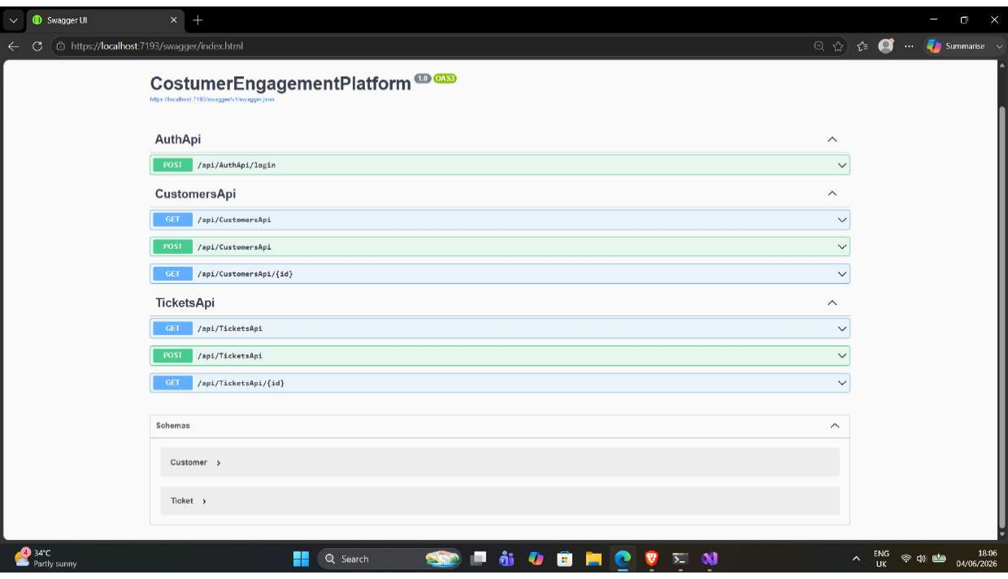
Customer Engagement &
Service Analytics Platform
End-to-End Walkthrough: UI → Controller → EF Core → SQL Server
Presented by: Anuja Salve
Landing page / starting point
ASP.NET Core MVC
EF Core + SQL Server
Swagger APIs
Professional review deck covering architecture, screenshots, core logic, practices, design patterns and Q&A preparedness.
Swagger API testing

Slide 2
Customer Engagement & Service Analytics Platform
Problem Statement & Objectives
Problem Statement
Project Objectives
• Customer data and support requests are difficult to track manually.
• Teams need one place to view customers, tickets, status and priority.
• Admin and user access must be separated to prevent unauthorized actions.
• The system should expose APIs so data can be tested and integrated later.
• Build a centralized Customer Engagement & Service Analytics platform.
• Support Customer CRUD and Ticket CRUD using MVC screens.
• Persist data through EF Core and SQL Server migrations.
• Provide secured dashboards, REST APIs, Swagger testing and basic unit tests.
2/18

Slide 3
Customer Engagement & Service Analytics Platform
Agenda for the 18-Slide Walkthrough
Foundation
Demonstration + Readiness
• Problem statement & objectives
• Application scope and user roles
• Architecture and technology stack
• Database schema and EF Core
• API endpoints and Swagger
• UI-to-database demo screenshots
• Security and role-based access
• SOLID principles: evidence-based assessment
• Design patterns and industry practices
• Top modules, best practices, Q&A readiness
3/18

Slide 4
Customer Engagement & Service Analytics Platform
Architecture of the Project
Users
Browser
Presentation Layer
Razor Views + Bootstrap
Business Logic Layer
MVC + API Controllers
Data Access Layer
EF Core DbContext
Database
SQL Server
Authentication & Authorization
API & Security Layer
DevOps / Quality Layer
Cookie-based MVC login, role claims, [Authorize] attributes, Admin/User dashboards and AccessDenied page.
CustomersApi, TicketsApi and AuthApi expose REST endpoints; AuthApi creates a JWT token for API login testing.
Swagger/OpenAPI, Dockerfile, GitHub workflow and three xUnit checks support testing and delivery readiness.
4/18

Slide 5
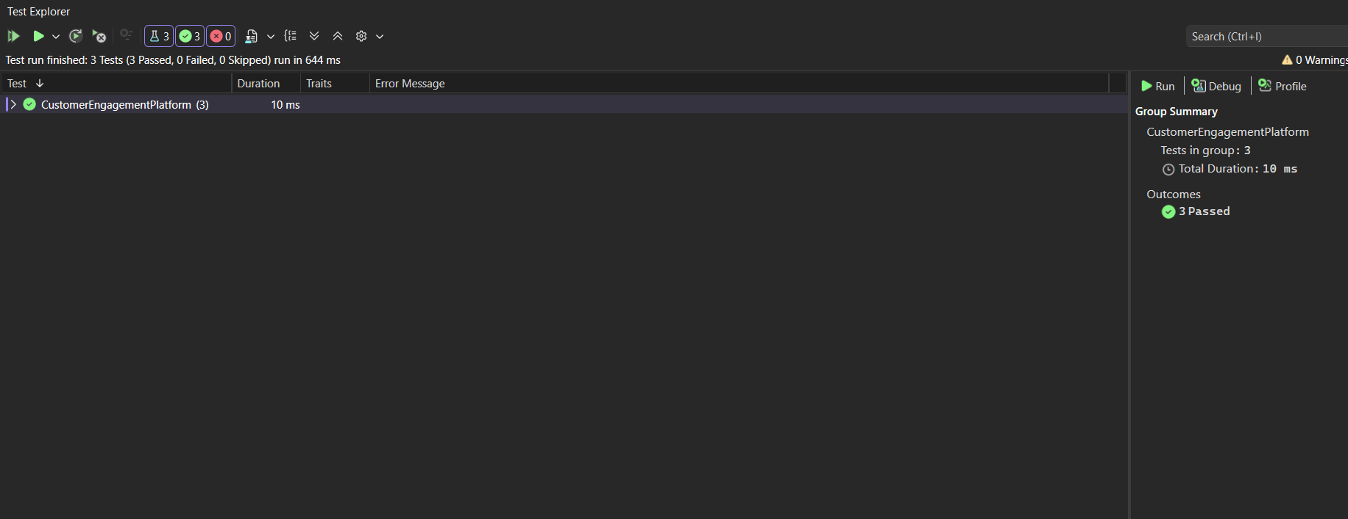
Customer Engagement & Service Analytics Platform
Technology Stack & Project Scope
Frontend
Program.cs configuration
Razor Views, Bootstrap 5, Tag Helpers, validation messages
builder.Services.AddControllersWithViews();
builder.Services.AddDbContext<ApplicationDbContext>(options =>
options.UseSqlServer(builder.Configuration.GetConnectionString("DefaultConnection")));
builder.Services.AddSwaggerGen();
builder.Services.AddAuthentication(CookieAuthenticationDefaults.AuthenticationScheme)
.AddCookie(options => {
options.LoginPath = "/Account/Login";
options.AccessDeniedPath = "/Account/AccessDenied";
});
Backend
ASP.NET Core MVC controllers + API controllers
Database
Entity Framework Core, SQL Server, migrations
Security
Cookie authentication, role-based authorization, JWT generation for APIs
Testing / Tools
Swagger, xUnit, Dockerfile, GitHub workflow
Unit test output in the attached project
5/18

Slide 6
Customer Engagement & Service Analytics Platform
Project Structure: What Each Folder Does
Solution layout
Controllers
CostumerEngagementPlatform
├── Controllers
│ ├── AccountController.cs
│ ├── CustomersController.cs / TicketsController.cs
│ └── AuthApiController.cs / CustomersApiController.cs / TicketsApiController.cs
├── Models
│ ├── Customer.cs, Ticket.cs, LoginViewModel.cs
├── Data
│ └── ApplicationDbContext.cs
├── Migrations
│ └── EF Core database history
├── Views
│ ├── Account, Customers, Tickets, Shared
├── wwwroot
│ └── css, js, bootstrap assets
└── UnitTest1.cs, Dockerfile, GitHub workflow
Coordinate requests, validation, CRUD operations and redirects/responses.
Models
Represent domain entities and form/view inputs using DataAnnotations.
Data + Migrations
Define DbSet<Customer>, DbSet<Ticket> and maintain SQL schema changes.
Views + wwwroot
Render the UI using Razor, Bootstrap, layout and static resources.
Quality / Delivery
Swagger for API verification, xUnit basics, Docker/CI artifacts.
6/18

Slide 7
Customer Engagement & Service Analytics Platform
Database Schema & EF Core Model
Customer
Ticket
• CustomerId (PK)
• Name, Email, Phone
• Address (optional)
• Tickets navigation collection
• TicketId (PK)
• Subject, Description
• Status = Open by default
• Priority = Medium by default
• CreatedDate
• CustomerId (nullable FK)
1 Customer
can have many Tickets
ApplicationDbContext
public DbSet<Customer> Customers { get; set; }
public DbSet<Ticket> Tickets { get; set; }
7/18

Slide 8
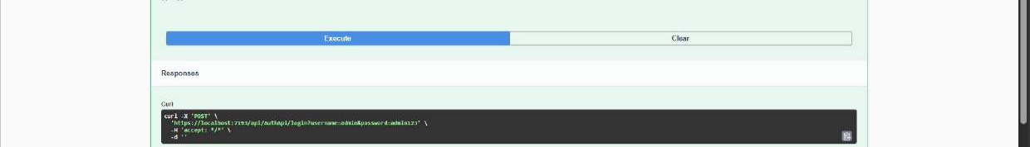
Customer Engagement & Service Analytics Platform
API Endpoints & Swagger Testing
Method
Endpoint
Purpose
POST
/api/AuthApi/login
Generates JWT for Admin/User demo login
GET
/api/CustomersApi
Returns customer list
GET
/api/CustomersApi/{id}
Returns one customer
POST
/api/CustomersApi
Creates customer record
GET
/api/TicketsApi
Returns ticket list
GET
/api/TicketsApi/{id}
Returns one ticket
POST
/api/TicketsApi
Creates ticket record
Swagger contract visible to tester/SME
API execution output / response
8/18

Slide 9
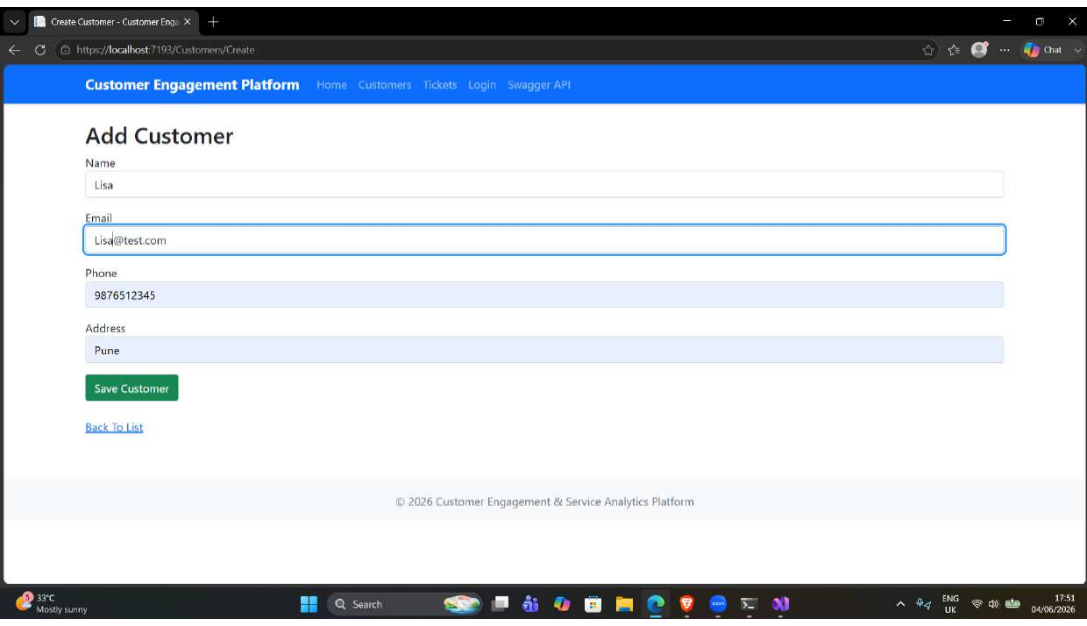
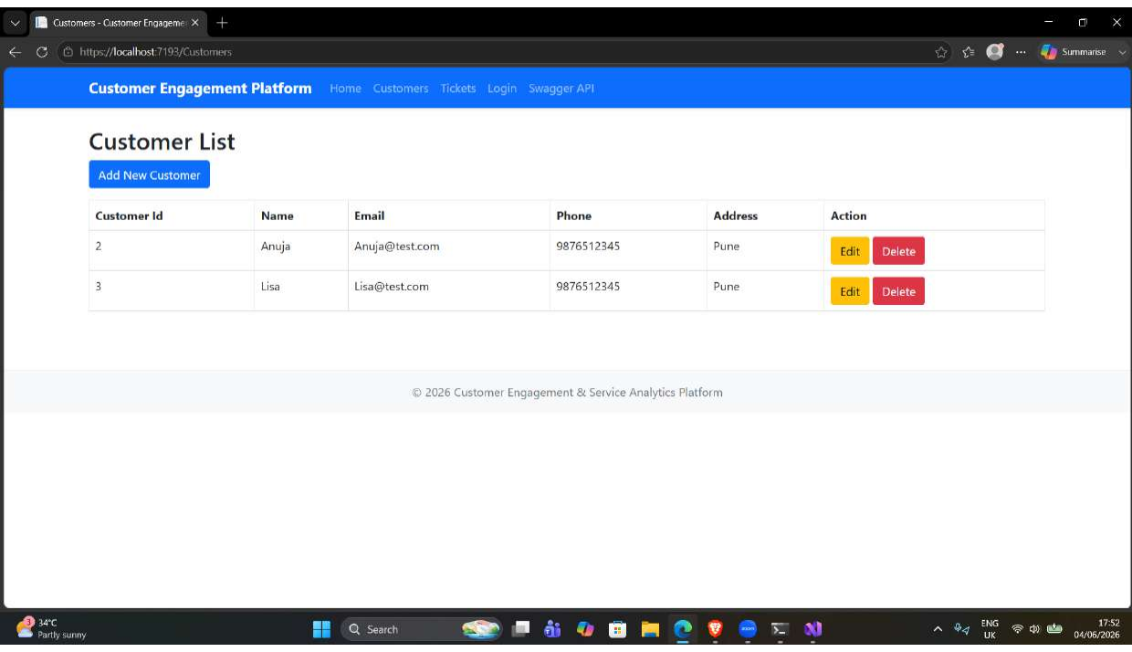
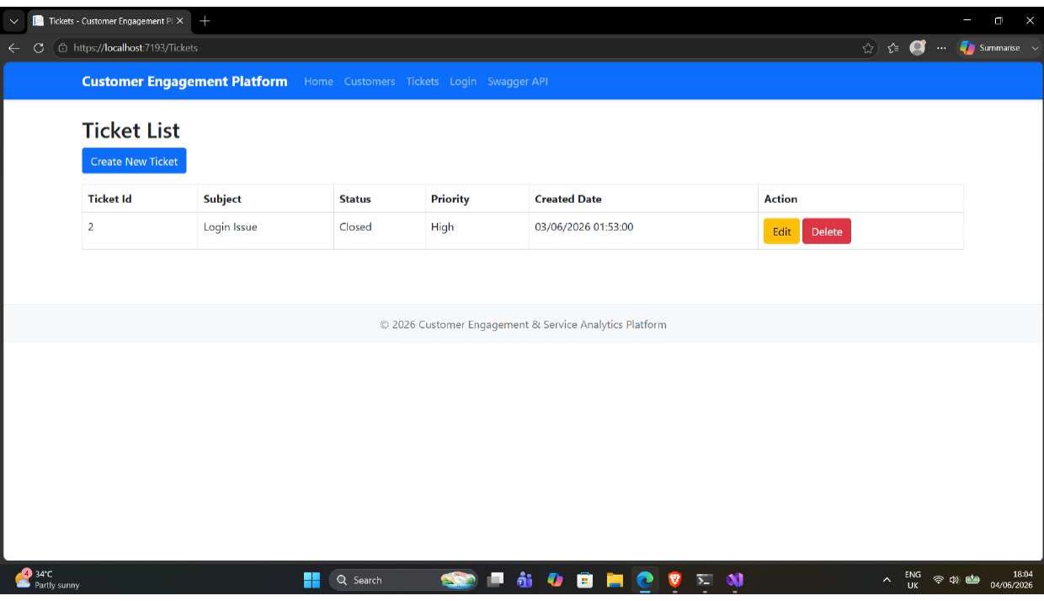
Customer Engagement & Service Analytics Platform
End-to-End Application Flow: UI to Database
User submits form
MVC action validates ModelState
EF Core tracks entity
SaveChangesAsync commits
SQL Server persists
Razor/Swagger shows output
Create customer screen
Customer saved and listed
Ticket created and displayed
9/18

Slide 10
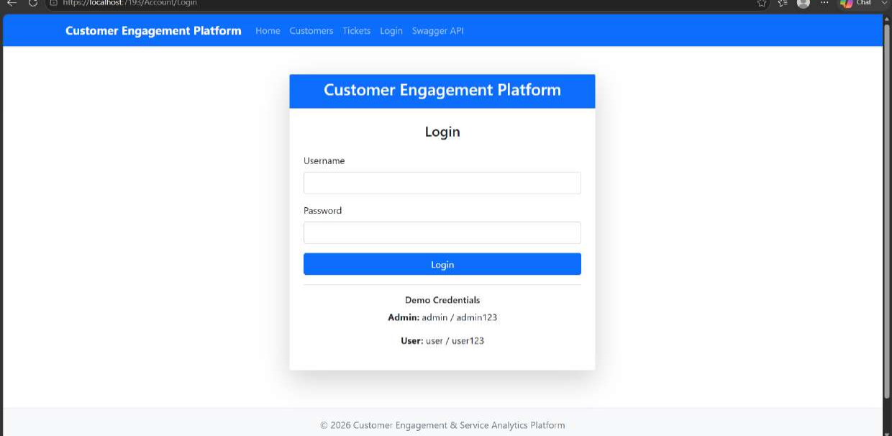
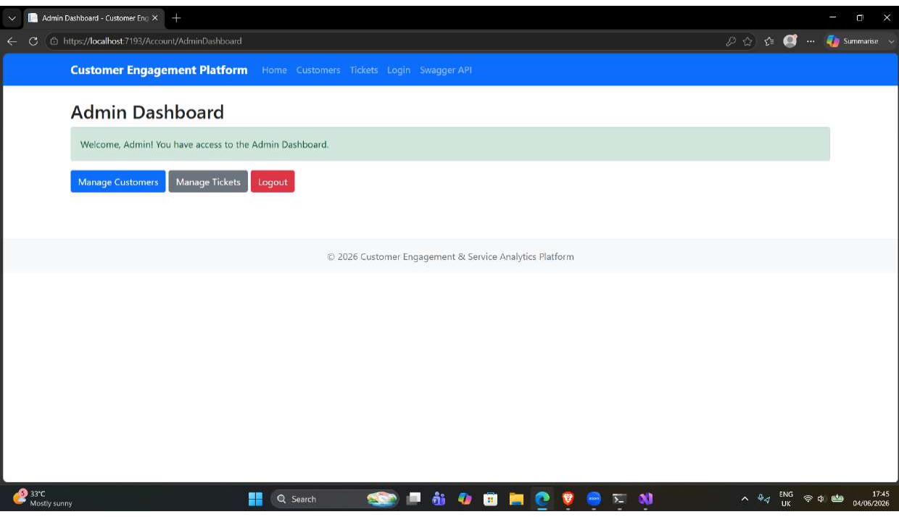
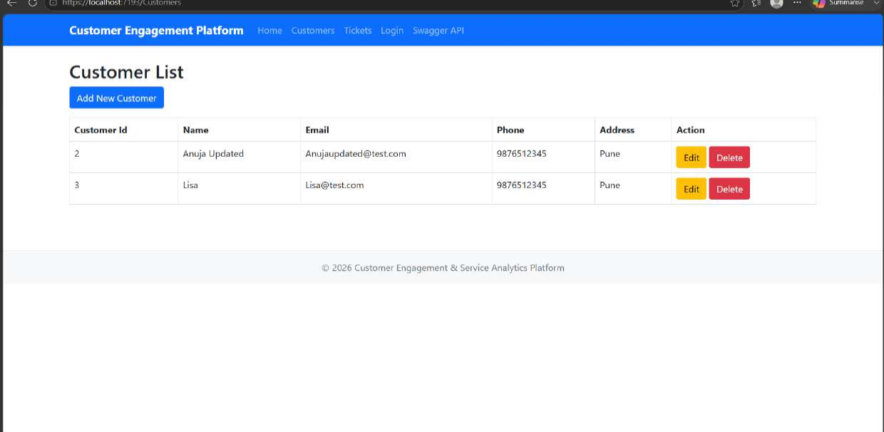
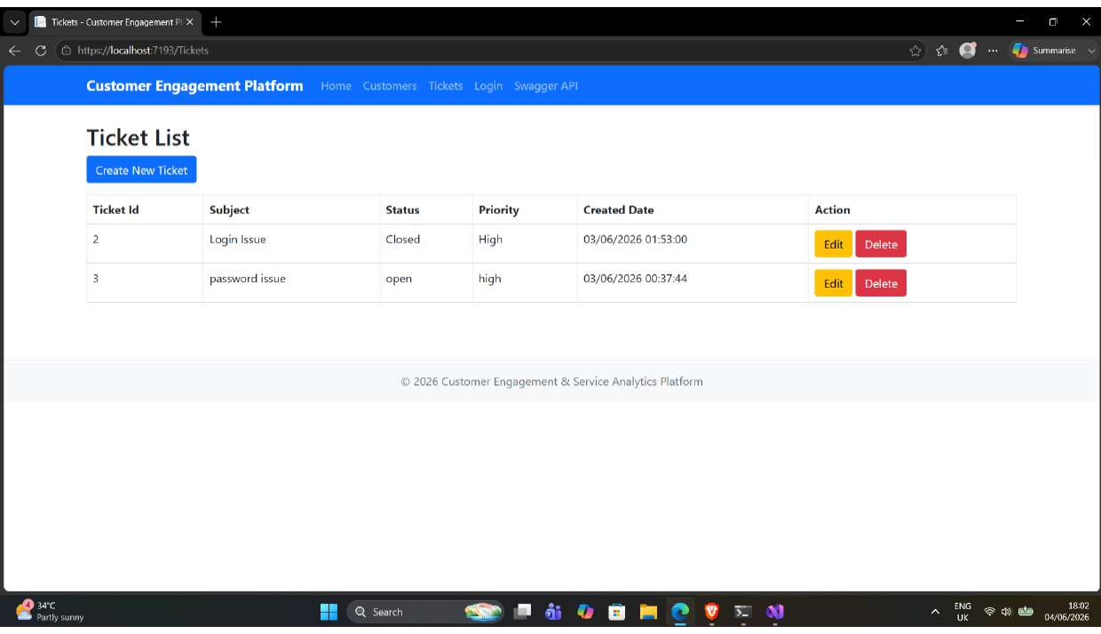
Customer Engagement & Service Analytics Platform
Screenshots with Output & Explanation for Core Logic
Login screen
Admin dashboard
Edited customer output
Ticket list
Authentication output
Customer CRUD output
Ticket workflow output
Valid demo credentials create role claims and redirect to the correct dashboard.
Create/Edit/Delete actions write to the database and refresh the list view.
Ticket data shows subject, description, status, priority and created date.
TicketsController Create POST logic
if (ModelState.IsValid) {
_context.Tickets.Add(ticket);
await _context.SaveChangesAsync();
return RedirectToAction(nameof(Index));
}
10/18

Slide 11
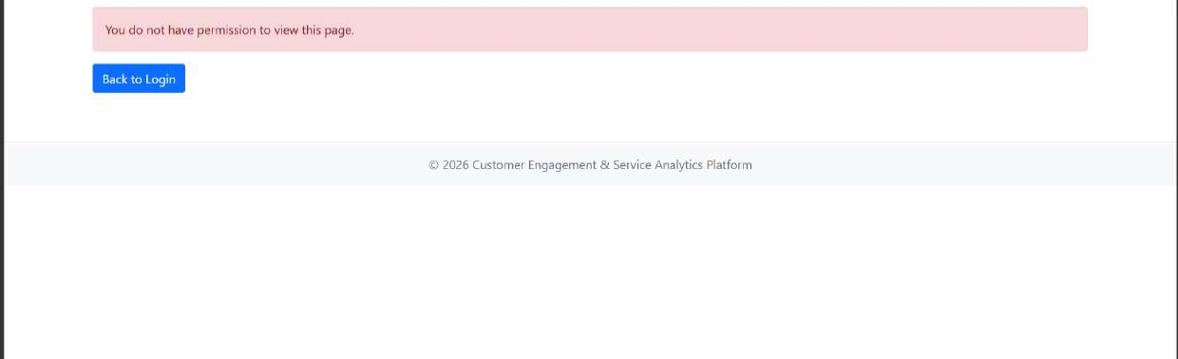
Customer Engagement & Service Analytics Platform
Security: Authentication, Authorization & Role Access
Login
admin/user
ClaimsIdentity
Name + Role
Cookie Sign-In
MVC session
[Authorize]
Dashboard gating
Role-based authorization in code
new Claim(ClaimTypes.Name, username),
new Claim(ClaimTypes.Role, role)
[Authorize(Roles = "Admin")]
public IActionResult AdminDashboard() => View();
[Authorize(Roles = "User")]
public IActionResult UserDashboard() => View();
Access denied result for unauthorized flow
11/18

Slide 12
Customer Engagement & Service Analytics Platform
SOLID Principles: What We Actually Used
Evidence-based answer: the project follows some SOLID ideas, but not all of SOLID completely. The most accurate claim is “partially followed, with improvement scope.”
S — Single Responsibility
O — Open/Closed
L — Liskov Substitution
Mostly followed: Customer, Ticket, LoginViewModel, DbContext and controllers have recognizable responsibilities. Controllers still contain direct data-access logic, so service extraction would improve it.
Partially followed: new controllers/views can be added without rewriting all modules. However status/priority are strings, so stronger enums/services would make extension cleaner.
Limited direct evidence: the app uses framework abstractions like Controller, ControllerBase and IActionResult, but no custom inheritance hierarchy proves LSP strongly.
I — Interface Segregation
D — Dependency Inversion
Limited evidence: models/viewmodels are focused, but there are no custom service interfaces to demonstrate ISP deeply.
Partially followed: ApplicationDbContext and ILogger are injected by DI. For stronger DIP, controllers should depend on repository/service interfaces rather than DbContext directly.
12/18

Slide 13
Customer Engagement & Service Analytics Platform
Design Patterns Followed in the Project
MVC Pattern
Dependency Injection
Repository / Unit of Work via EF Core
Views display data, controllers handle requests, models represent the domain.
ApplicationDbContext and ILogger are injected through constructors and configured in Program.cs.
DbSet behaves as repository-like collection; DbContext tracks changes and commits via SaveChangesAsync.
Middleware Pipeline
Attribute Routing / Action Filters
ViewModel Pattern
UseSwagger, UseHttpsRedirection, UseRouting, UseAuthentication and UseAuthorization form the request pipeline.
[Route], [ApiController], [HttpGet], [HttpPost], [Authorize], [ValidateAntiForgeryToken].
LoginViewModel keeps login form data separate from Customer/Ticket entities.
DI constructor example
public CustomersController(ApplicationDbContext context)
{
_context = context;
}
13/18

Slide 14
Customer Engagement & Service Analytics Platform
Traditional vs Latest Industry Dos & Don’ts
Avoid: Traditional / Risky
Followed / Recommended Modern Approach
• Spreadsheet/email-based customer issue tracking
• Business logic mixed everywhere without layering
• Plain postbacks without validation/security filters
• Manual API testing with no contract view
• Hard-coded secrets in production
• No automated checks before delivery
• Layered MVC structure: Views, Controllers, Models, Data
• EF Core async CRUD and migrations
• Role-based access and anti-forgery on MVC POSTs
• Swagger for API contract and testing
• Secure configuration for production secrets
• xUnit tests + CI/Docker foundation
14/18

Slide 15
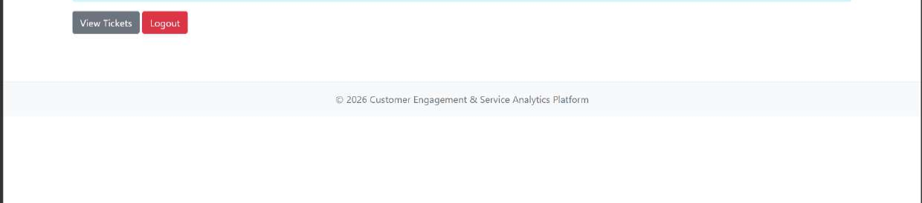
Customer Engagement & Service Analytics Platform
Top 10 Important Concepts / Modules Explained
1
AccountController: login, logout, dashboards and access control
2
CustomersController: MVC customer CRUD
3
TicketsController: MVC ticket lifecycle
4
CustomersApiController: customer REST API
5
TicketsApiController: ticket REST API
6
AuthApiController: JWT generation for API login
7
ApplicationDbContext: EF Core database gateway
8
Customer & Ticket models: domain schema and validation
9
Razor Views: forms, tables and user workflows
10
Swagger, xUnit, Docker/CI: testing and delivery support
User dashboard module
Admin dashboard module
15/18

Slide 16
Customer Engagement & Service Analytics Platform
Best Practices Followed as per Industry Standards
Separation of Concerns
Async Data Access
Validation
Views, controllers, models, data context and migrations are placed in clear folders.
Controller actions use ToListAsync, FindAsync and SaveChangesAsync for database operations.
DataAnnotations and ModelState checks protect forms before saving.
Security Checks
API Visibility
Delivery Foundation
[Authorize] roles and [ValidateAntiForgeryToken] are used on secured workflows.
Swagger makes API behavior testable and presentable to SMEs.
Dockerfile, GitHub workflow and unit tests show readiness beyond local execution.
Testing evidence: attached test case output
16/18

Slide 17
Customer Engagement & Service Analytics Platform
Q&A Readiness: SME Panel Preparation
Prepared answers should be honest, technical and business-aligned.
Architecture
Business Value
3-tier MVC: Razor UI → Controllers → EF Core DbContext → SQL Server.
Centralizes customers and tickets, improves status visibility and reduces manual tracking.
Security
SOLID
Cookie auth drives MVC login; roles gate Admin/User dashboards. JWT exists for API login demo.
Partially applied: SRP and DI are visible; stronger DIP/ISP needs service interfaces.
Database
Future Scope
Customer-to-ticket relationship uses CustomerId; Ticket supports status, priority and created date.
Replace hard-coded users, hash passwords, add analytics dashboard, email notifications and stronger tests.
Suggested closing line:
“This project is a working, database-backed MVC application with secure role-based access, Swagger APIs and a clear path for production hardening.”
17/18

Slide 18
THANK YOU
Questions & Discussion
UI demonstration
API demonstration
Ticket workflow
18/18

